Slide 1

Functions Review

Slide 2
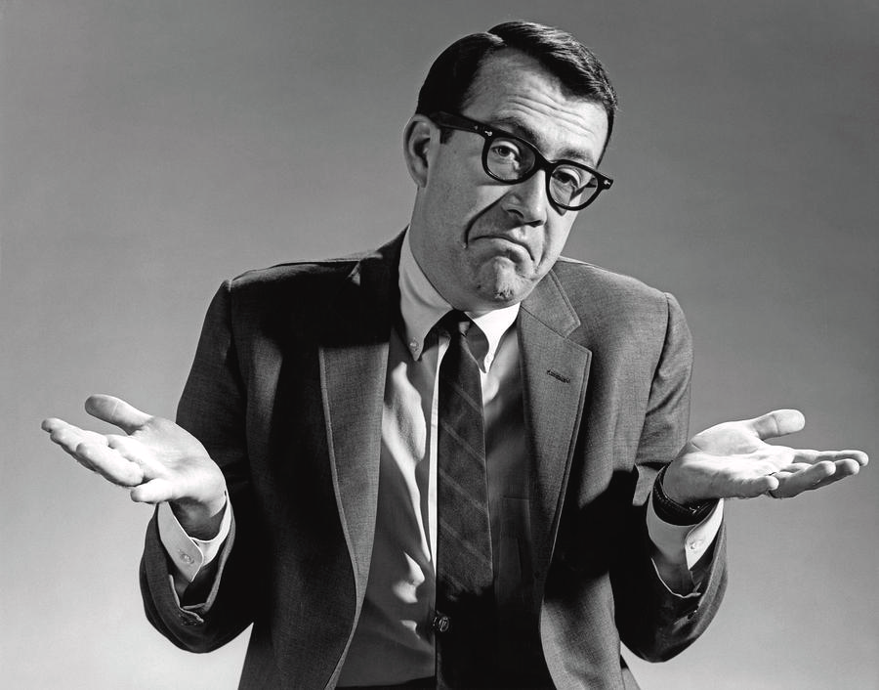
Things you know, but probably forgot

Slide 3
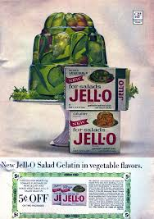
What is a function?
As a baseline, a function is a set of instructions that you can pass around.
It’s a recipe.
Imagine you went to a dinner party, and loved the jello centerpiece! You can’t live without it. But you aren’t the only one. It was such a smash hit, that 10 people would like the recipe too. What would be more efficient?
The host goes to every single person and tells them the instructions individually.
The host writes down the set of instructions, and hands it out.

Slide 4
The second option, of course. Option one is like rewriting the same code over and over. That is not efficient, or DRY, as developers say:
D - Don’t
R - Repeat
Y - Yourself
Always write your code in a concise way as possible. Put repeated code into functions.

Slide 5
Back to the Jello...
function amazingJelloFantastico(jello, veg1, veg2, fruit, otherIng ){
let mix = "Stir";
jello = jello + mix;
let result = jello + veg1 + veg2 + fruit + otherIng;
result = result + mix;
return result;
}
amazingJelloFantastico("lime", "cucumber", "onions", "maraschino cherries", "sliced olives");
Amazing Jello Fantastico
Ingredients:
One package lime jello
1 cup sliced cucumber
1 cup sliced onions
2 cups maraschino cherries
3 cups sliced olives
Instructions:
Prepare jello according to package directions in a large bowl.
Mix the rest of the ingredients in with the jello.
Pour mixture into mould.
Let set in fridge overnight.
De-mould and enjoy.

Slide 6
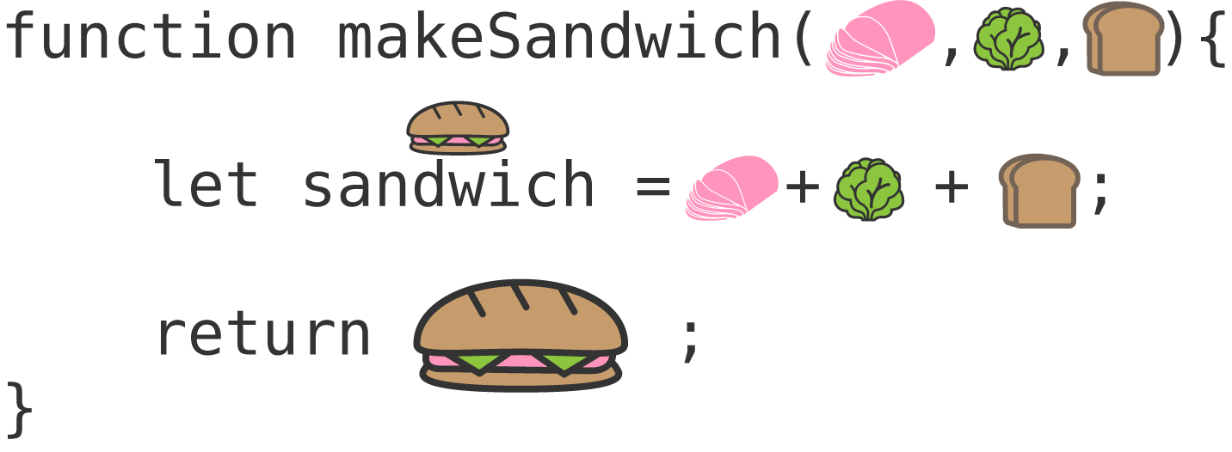
Alright, that was a really dumb example.
And the code doesn’t even run….
What I’m getting at is that functions are simply a set of instructions. Let’s look at some code that will actually run:
https://www.codeanalogies.com/javascript-functions-explained

Slide 7
In non-visual terms:
function makeSandwitch(meat, veg, bread){
let sandwitch = meat + veg + bread;
return sandwitch;
}
makeSandwitch("ham", "lettuce", "wheat");
//hamlettucewheat

Slide 8
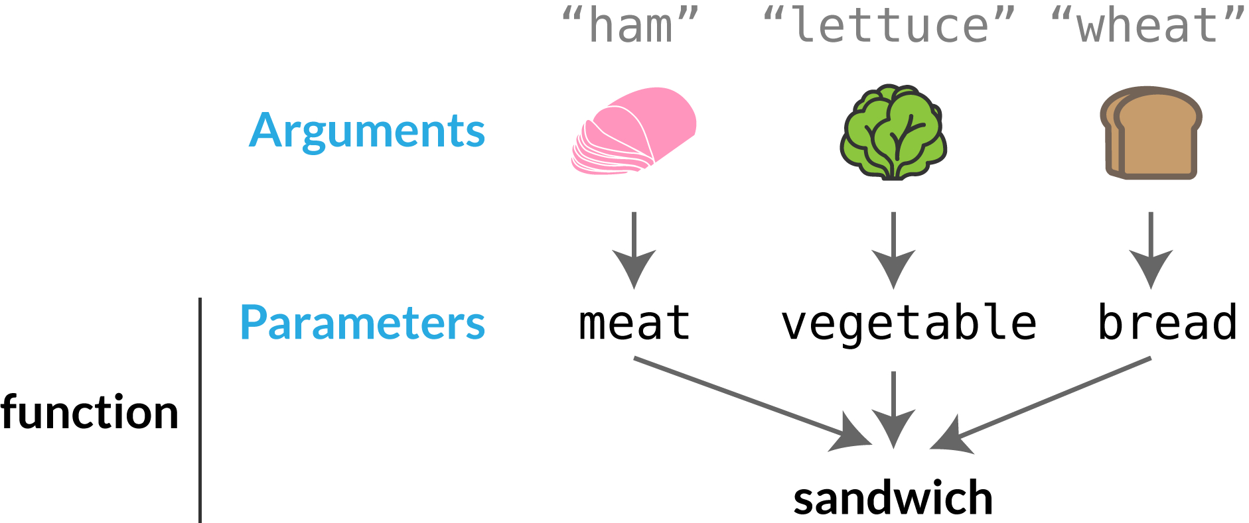
There are a couple of types of functions:
Functions that take in parameters and return a value.
Functions that don’t take in parameters and don’t return a value.
https://www.codeanalogies.com/javascript-functions-explained

Slide 9
Return a Value
Doesn’t Return a Value
num1 = 8;
function addTwo(){
console.log(num1+2)
}
addTwo();
//10 in console
// => undefined
function addTwo(num){
let sum = num + 2;
return sum;
}
addTwo(8);
// => 10

Slide 10

What’s the difference?
A function that has parameters is much more dynamic and can be passed around in your code more easily, since it does not rely on global variables.
Functions that do not return a value are generally used to manipulate global variables, but it comes down to style and taste.

Slide 11
Exercise: Functions of FizzBuzz
If you haven’t done FizzBuzz yet, lucky you! It is a staple of learning a new computer language. Print out the numbers between 1 and 100. If the number is divisible by 3, print “Fizz” instead. If the number is divisible by 5, print “Buzz” instead. If it is divisible by both 3 and 5, print “FizzBuzz”.
Create a function fizzBuzz, that has no parameters, and accomplishes the instructions.
Create a function fizzBuzzTwo, that takes in two numbers, and does the FizzBuzz to those values. For example, 8 and 9, instead of 3 and 5.
Create a function fizzBuzzSum, which has two parameters, and returns the sum of the numbers that are not “Fizz”, “Buzz” and “FizzBuzz”.

Slide 12

Why is this important?
“Ah ha!” , you say. “I already know all this stuff. This is really low level review!”
Well, my friend, it is the basis of callbacks, jQuery events and higher level programming. So, if this is fuzzy, really dig deep, have it re-explained and have it solid in your brain.
We are going to jump into callbacks next, so make sure you know this.

Slide 13
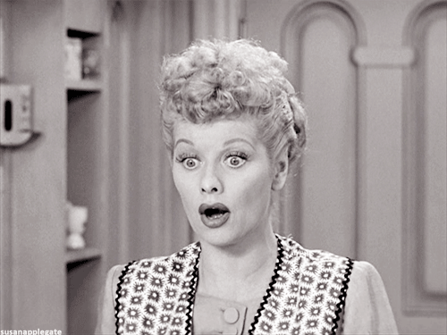
Surprise! Functions are Data Types!
I know, right?!!
Along with Objects, Functions are complex data types in JavaScript.
What does that mean for you?
Well, that simply means that we can look at functions as values, like any other data type. If we think of them that way, callbacks are much simpler than we think they are.

Slide 14
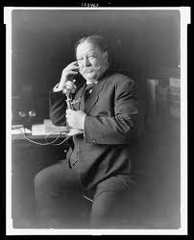
Callback: what the heck is it?
In simple terms, a callback is a function that is to be executed after another function has finished executing — hence the name ‘call back’.

Slide 15
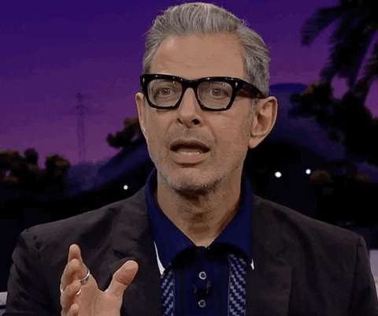

Slide 16
Um...examples please?
Okay, in just a second. I’ll finish explaining and then we’ll go through some examples together.
As explained before, functions are objects (complex data types). Because of this, functions can take functions as arguments, and can be returned by other functions. Functions that do this are called higher-order functions. Any function that is passed as an argument is called a callback function.

Slide 17
Why do we need this?
JavaScript is an event driven language, This means that instead of waiting for a response before moving on, JavaScript will keep executing while listening for other events. What happens when you run these?
function first(){
console.log(1);
}
function second(){
console.log(2);
}
first();
second();
function first(){
setTimeout(function(){
console.log(1)}, 500);
}
function second(){
console.log(2);
}
first();
second();

Slide 18
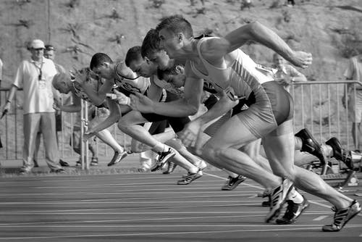
So, JavaScript keeps on running, even with a code delay?
Yup! In the second example, it’s not that JavaScript didn’t execute our functions in the order we wanted it to, it’s instead that JavaScript didn’t wait for a response from first()before moving on to execute second().

Slide 19
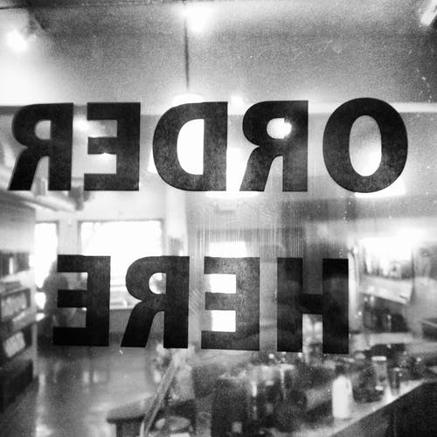
So why show you this?
Because you can’t just call one function after another and hope they execute in the right order. Callbacks are a way to make sure certain code doesn’t execute until other code has already finished execution.

Slide 20
A simple jQuery callback function:
$("p").on("click", function(){
alert("The paragraph was clicked.");
});

Slide 21
$("p").on()
Don’t be scared. We know the selector part, then we use the .on() method. This allows for all kinds of events, like mouse hover, clicks, etc.
...("click", function(){
alert("The paragraph was clicked.");
});
We then tell the .on() method what kind of event we want. I chose “click”. Next comes the callback. We are telling jQuery what we want to happen when we click the paragraph. We could do anything! Log something to the console, make the paragraph fly around, or make a sound. In this case, an annoying alert pops up and says “The paragraph was clicked.”

Slide 22
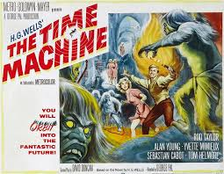
setTimeout
setInterval
clearInterval
Practice Time!!!
Let’s get Coding!!

Slide 23
Functions that use callbacks
We are going to practice callbacks with 3 built in functions in JavaScript:
setTimeout
setInterval
clearInterval

Slide 24
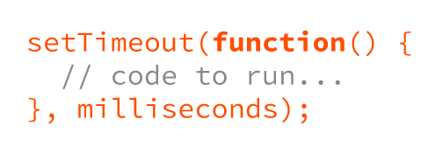
setTimeout
Callback function

Slide 25
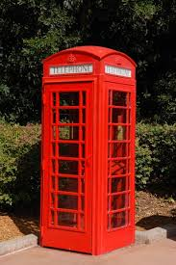
As we learned before, the function you pass in to a setTimeout is named a callback function.

Slide 26
Exercise
Write a script that logs to the console “Loading…” and then, 3 seconds later, “Hello, World!”
Stretch: Make your console display “Ready…”, then “Set…”, then “Go!”, one second after another.

Slide 27
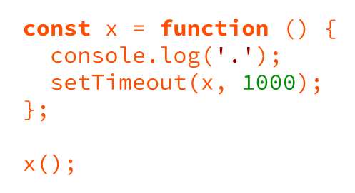
What Will Happen?

Slide 28
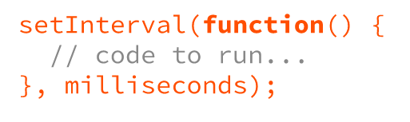
2. setInterval
Will run code every N seconds
Callback function

Slide 29
Exercise
Make a counter using setInterval. Count up from 1, every second.
Stretch: Create two counters, one for even numbers, one for odd. Run them at the same time.

Slide 30
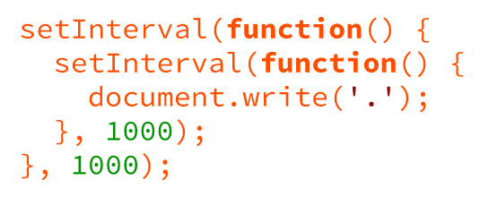
What Will Happen?

Slide 31
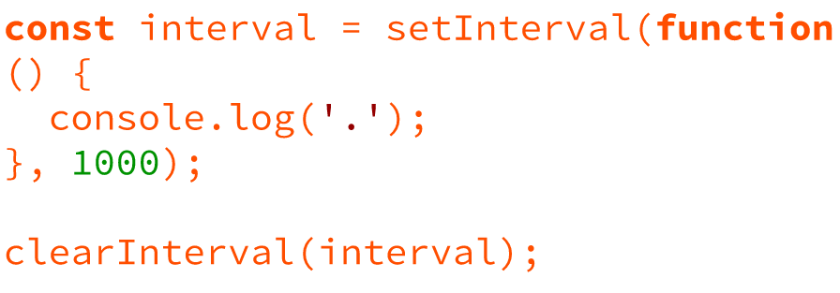
3. clearInterval
Callback function

Slide 32
Exercise
Use setInterval to log “ . “ to the console every second. Stop the logging after 10 seconds have passed.
Hint: use setTimeout to stop it.
Stretch: Build a blast-off countdown using setInterval.
10 9 8 7 6 5 4 3 2 1 Blast Off!!

